Slide 1
Azure Infrastructure as Code Bootcamp
Session 1 of 6: Infrastructure as Code
Session materials repository: timw.info/inebootcamp

Slide 2




Tim Warner
timothywarner316@gmail.com
@TechTrainerTim
timw.info/linkedin

Slide 3
Bootcamp Overview
Session 1: Infrastructure as Code
Session 2: Azure Compute Services
Session 3: Azure Network Services
Session 4: Azure High Availability & Fault Tolerance
Session 5: Azure Storage Services
Session 6: Identity and Access Management

Slide 4
Session 1 Agenda
Foundational principles
Git version control
Microsoft Azure infrastructure as code
Deploy infrastructure with CI/CD pipelines

Slide 5
Course Materials
timw.info/inebootcamp

Slide 6
Foundational Principles

Slide 7
Why IaC?
Consistency (avoiding human error)
Efficiency (much faster than manually deploying single instances)
Traceability (helps with compliance tracking)
Collaboration (all changes are tracked by all developers; DevOps culture)
Maintainability (Easier to update and see lifecycle)

Slide 8
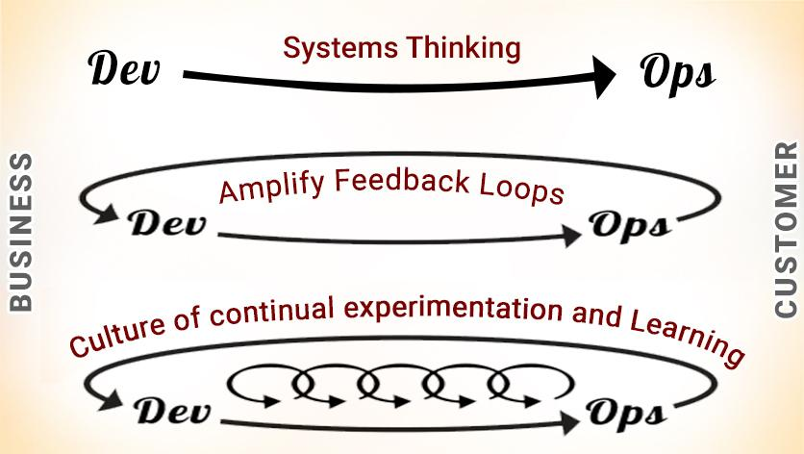
DevOps

Slide 9




DevOps Reading List

Slide 10
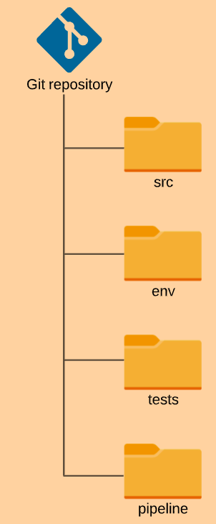
GitOps

Slide 11
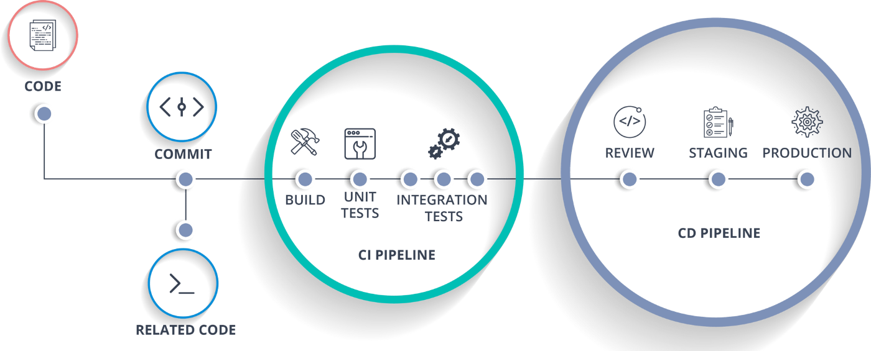
CI/CD

Slide 12
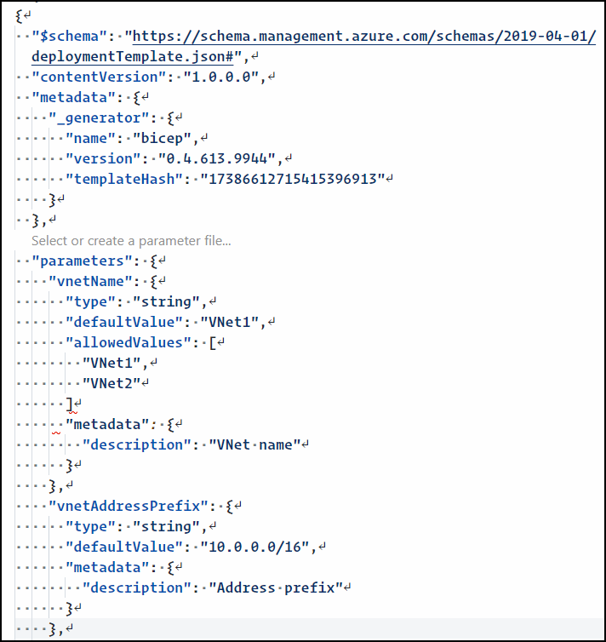

JavaScript Object Notation (JSON)

Slide 13
Git Source Code Control

Slide 14

Git
Created by Linus Torvalds in 2005
Open-source, decentralized source code management (SCM) solution
Every developer has full local copy of the repository
Supports collaborative development

Slide 15

GitHub
Cloud-based DevOps solution
Acquired by Microsoft in 2018
Allows Git to scale
Gradually gaining parity with Azure DevOps
Microsoft is doing their innovation at GitHub

Slide 16
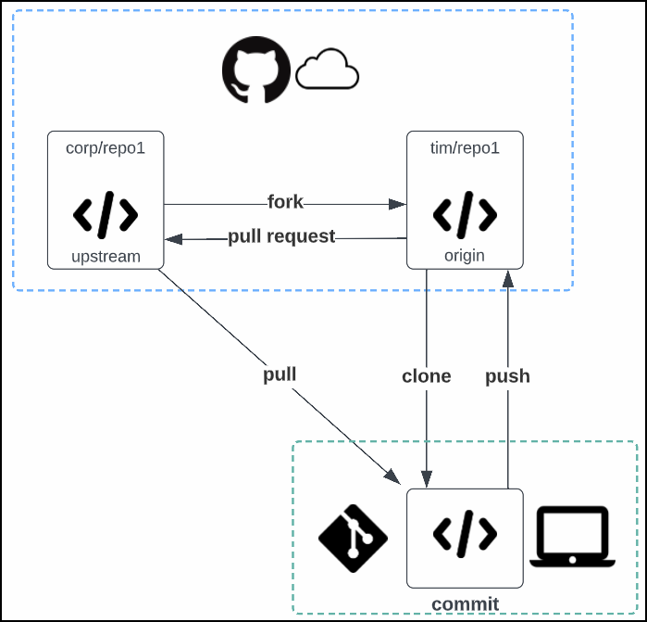
Git/GitHub Flow

Slide 17
Demo 1 of 3: Git and GitHub

Slide 18
Microsoft Azure Infrastructure as Code

Slide 19

ARM JSON Deployment Templates
Azure Resource Manager is a REST API
Create, Read, Update, Delete (CRUD) operations over HTTP
Data payload is JSON
More readable, more lightweight data format than XML

Slide 20
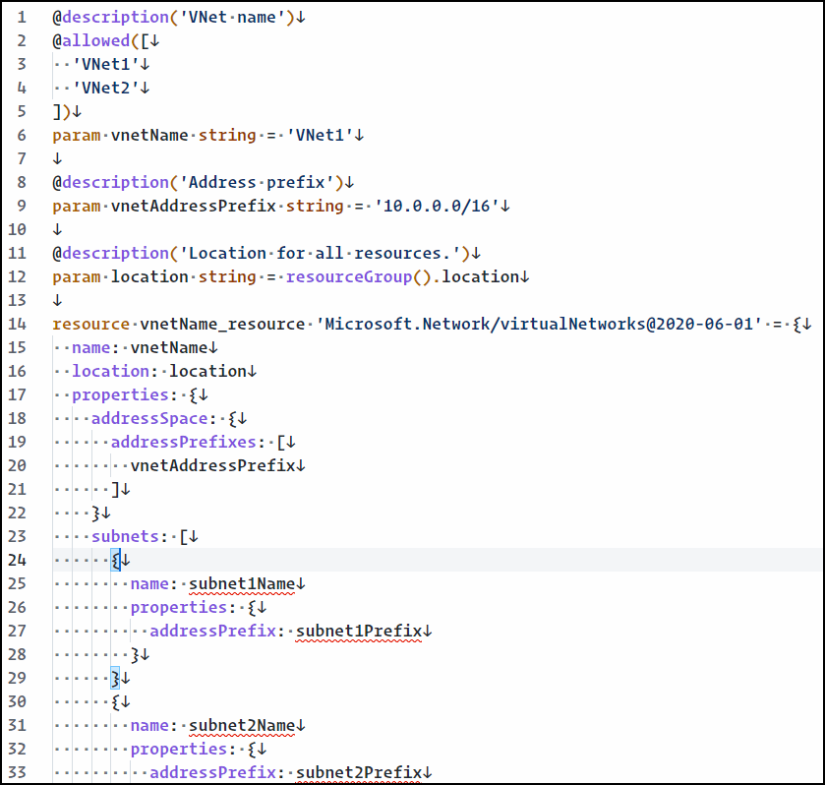

Azure Bicep
Domain-Specific Language (DSL)

Slide 21
Demo 2 of 3: ARM Templates with a Side of Bicep

Slide 22
Deploy Infrastructure with CI/CD Pipelines

Slide 23
CI/CD
"Shift left"

Slide 24

CI/CD Platforms
Azure DevOps
Azure Pipelines
Classic/YAML editors
GitHub
Actions
YAML editor

Slide 25
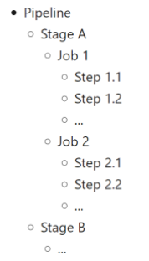
Pipeline Schema

Slide 26
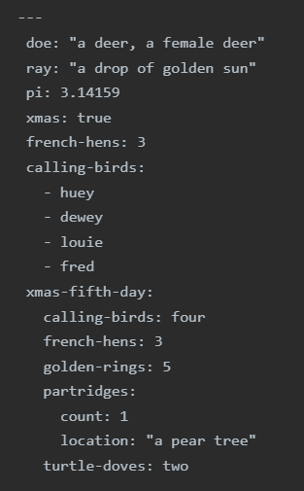
YAML
New doc
No tabs
Whitespace counts!

Slide 27
Demo 3 of 3: Deploy ARM Templates with GitHub Actions

Slide 28
Coming up...
Session 2: Azure Compute Services
Virtual machines
App Service
Functions
AKS

